Slide 1
Improving and extending CMS land surface carbon flux products
including estimates of uncertainties in fluxes and biomass.
Jim Collatz, Randy Kawa, Lesley Ott, Fanwei Zeng, Al Ivanoff, David Liu, Zhengxin Zhu
NASA's GSFC
15min
See Poster Session at lunch for more details and discussions

Slide 2
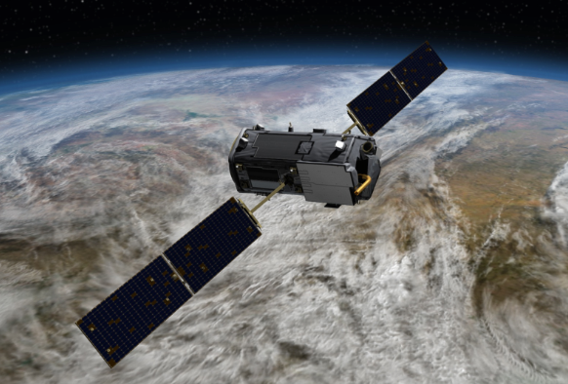
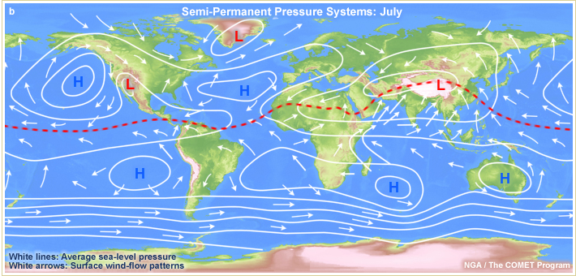
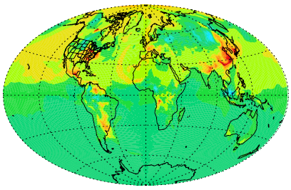
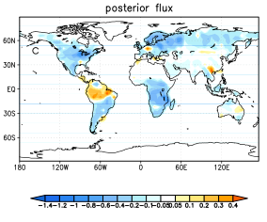
GSFC CASA-GFED3 System
Satellite data constrained diagnostic land carbon cycle model, monthly fluxes, MERRA meteorology, satellite veg
MERRA 3 hrly scaling of GPP (solar radiation),
RE (temperature), and fire emissions
temperature
Atmospheric Carbon
monthly NPP and Rh
NPP
July NBP (gC/m²/mo)
daily fire
solar
radiation
Live
Carbon Pools
Respiration
Fire
Ocean,
Fossil Fuel
fluxes
hours
Mortality
Dead
Carbon Pools
Uncertainty (1σ)
model
improvements
satellite CO2
GEOS5/PCTM transport, GEOS-Chem adjoint inversion
OSSEs
maps of CO2 variability
maps of sources/sinks
e.g. ASCENDS sampled
with errors
Notes:
Observing System Simulation Experiments

Slide 3
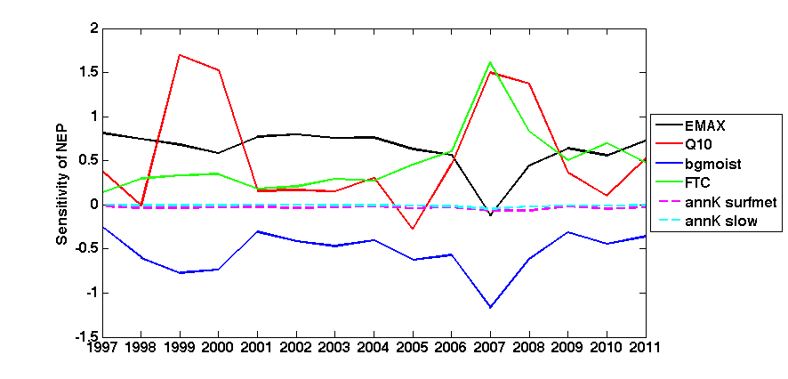
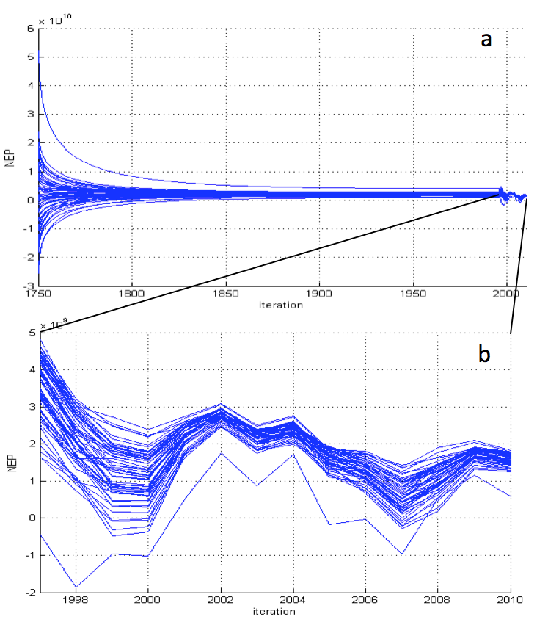
Flux and Biomass Uncertainty
Parameter sensitivity
Monte Carlo Ensemble
2011 Jul NBP, gC m⁻² mo⁻¹
2011 Jul NBP Uncertainty (1σ), gC m⁻² mo⁻¹
July NBP (gC/m²/mo)\
Forrest Aboveground Biomass, MgC/ha
Forrest Aboveground Biomass Uncertainty (1σ), MgC/ha

Slide 4
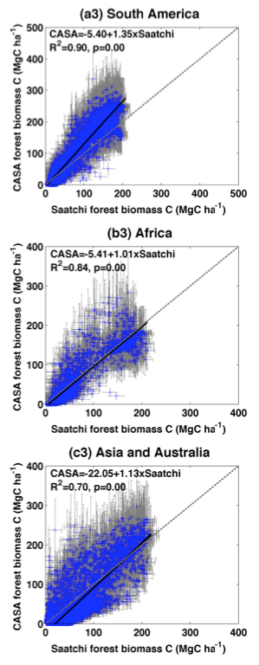
Biomass Comparisons
Tropical (Saatchi et al., 2011, GLASS)
Temperate/Boreal (Thurner et al., 2013, ASAR)
CONUS (Blackard et al., 2008, MODIS)

Slide 5
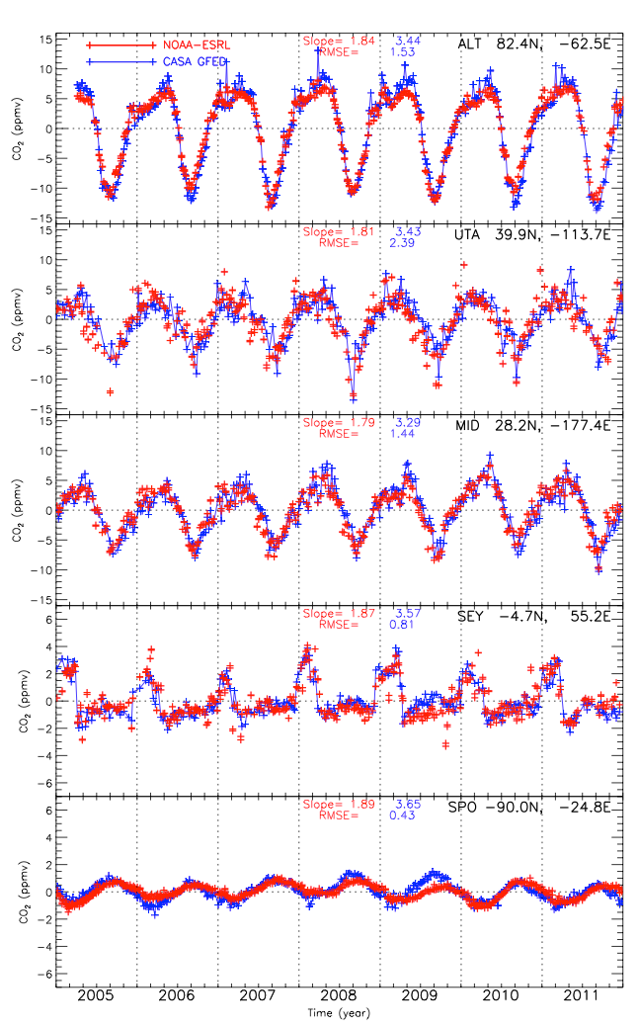
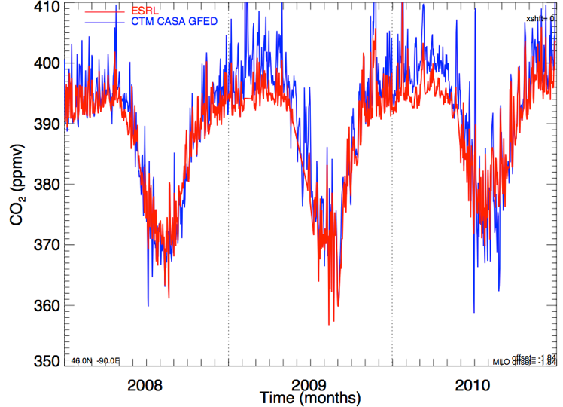
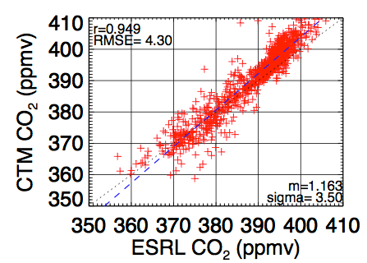
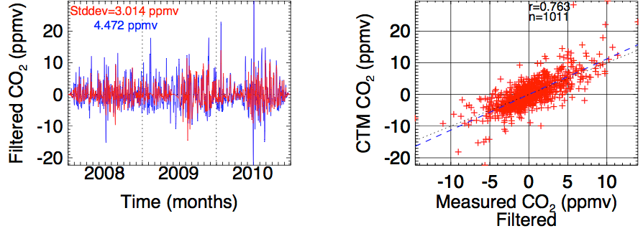
NOAA Surface Flask and Continuous Measurement Comparisons (PCTM)

Slide 6
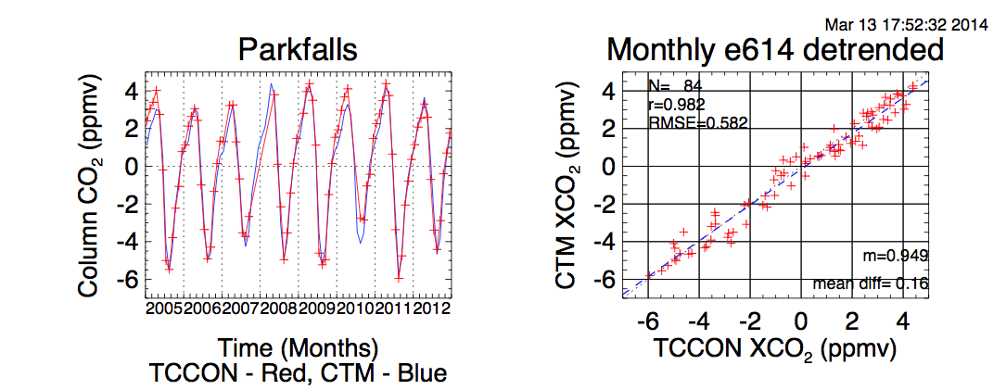
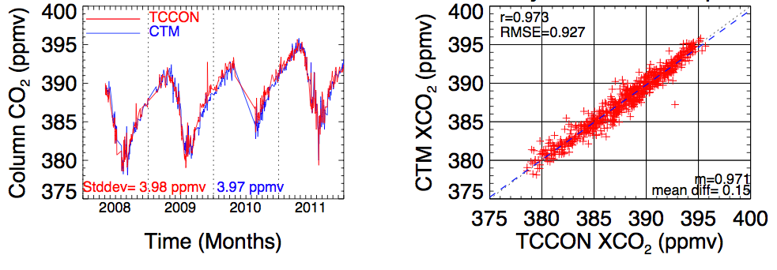
TCCON Column CO₂ Comparisons (PCTM)
Monthly
Daily with sink

Slide 7
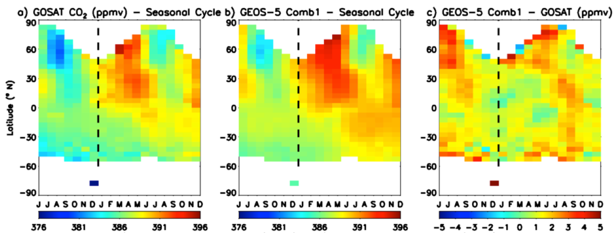
Atmospheric Profile Comparisons
HIPPO Phase II, Oct & Nov 2009 (GEOS-5)
GOSAT Comparisons (GEOS-5)

Slide 8
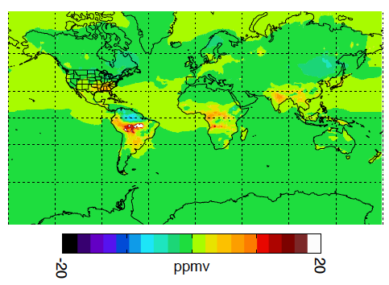
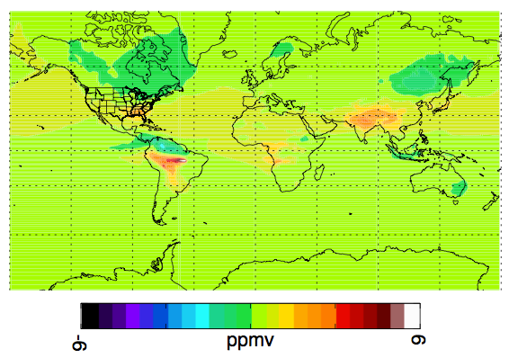
Sensitivity: Surface versus Column (PCTM)
FIRE – NO FIRE
August 2010
Surface
>18ppm
Column
<4ppm

Slide 9
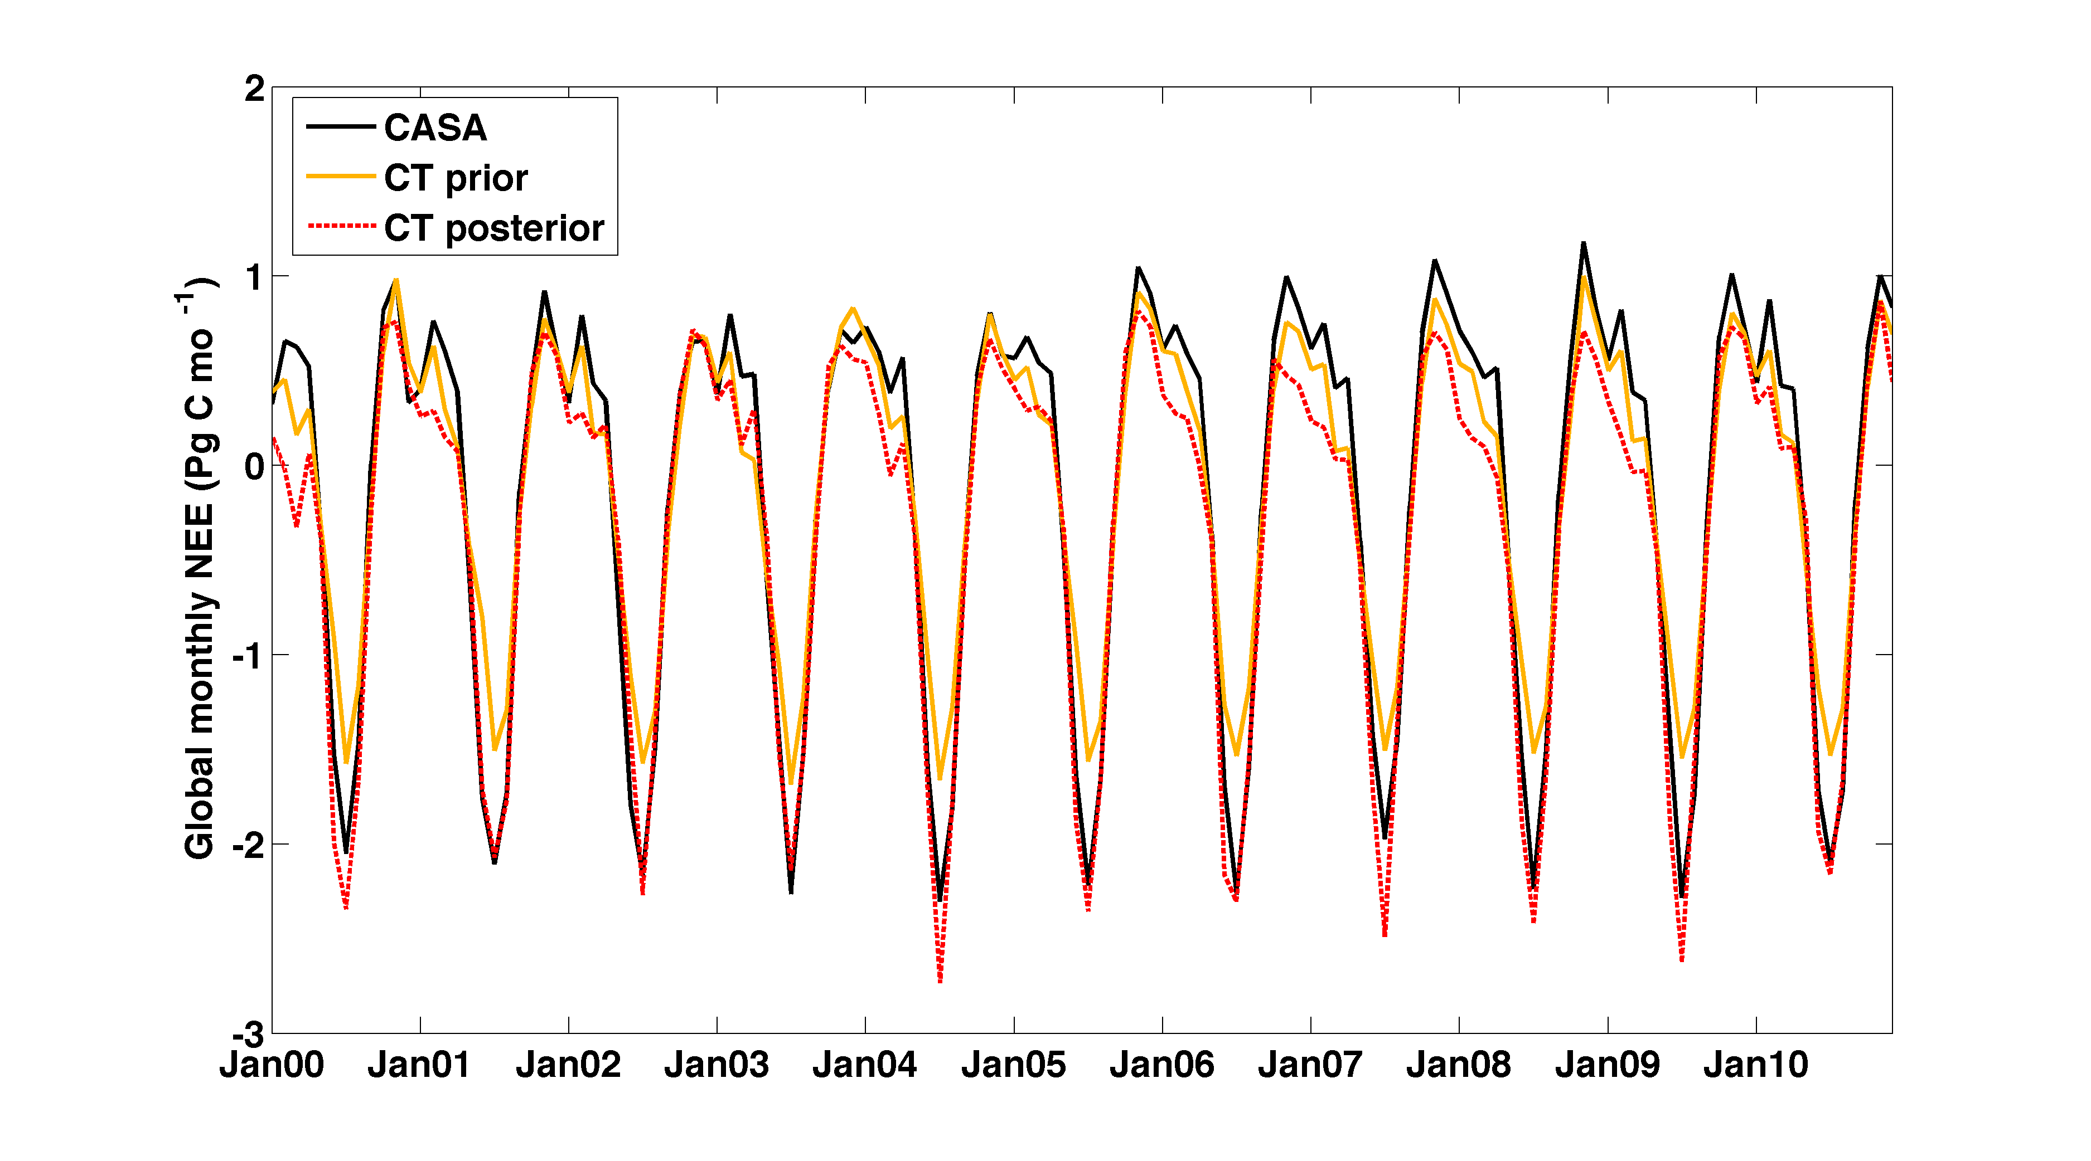
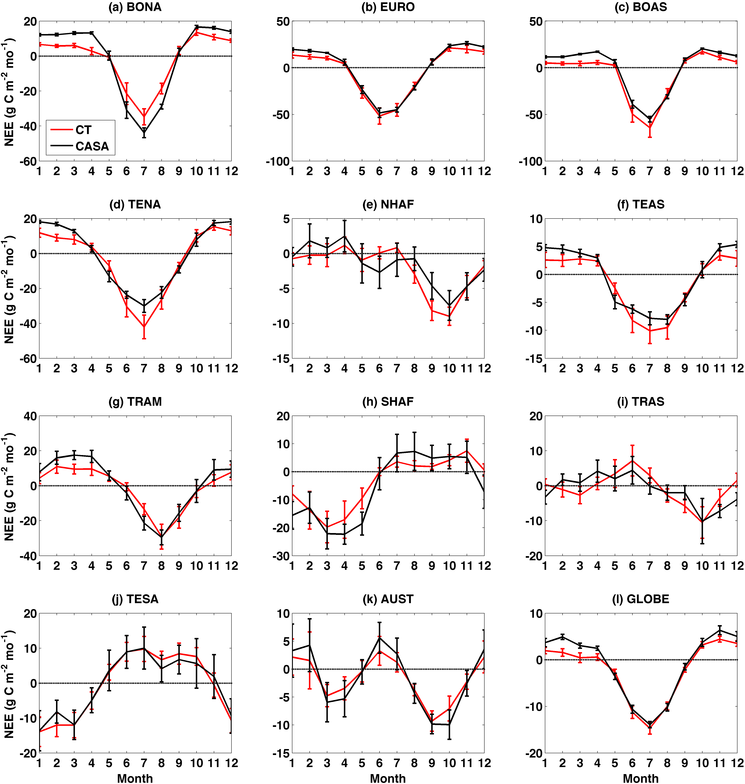
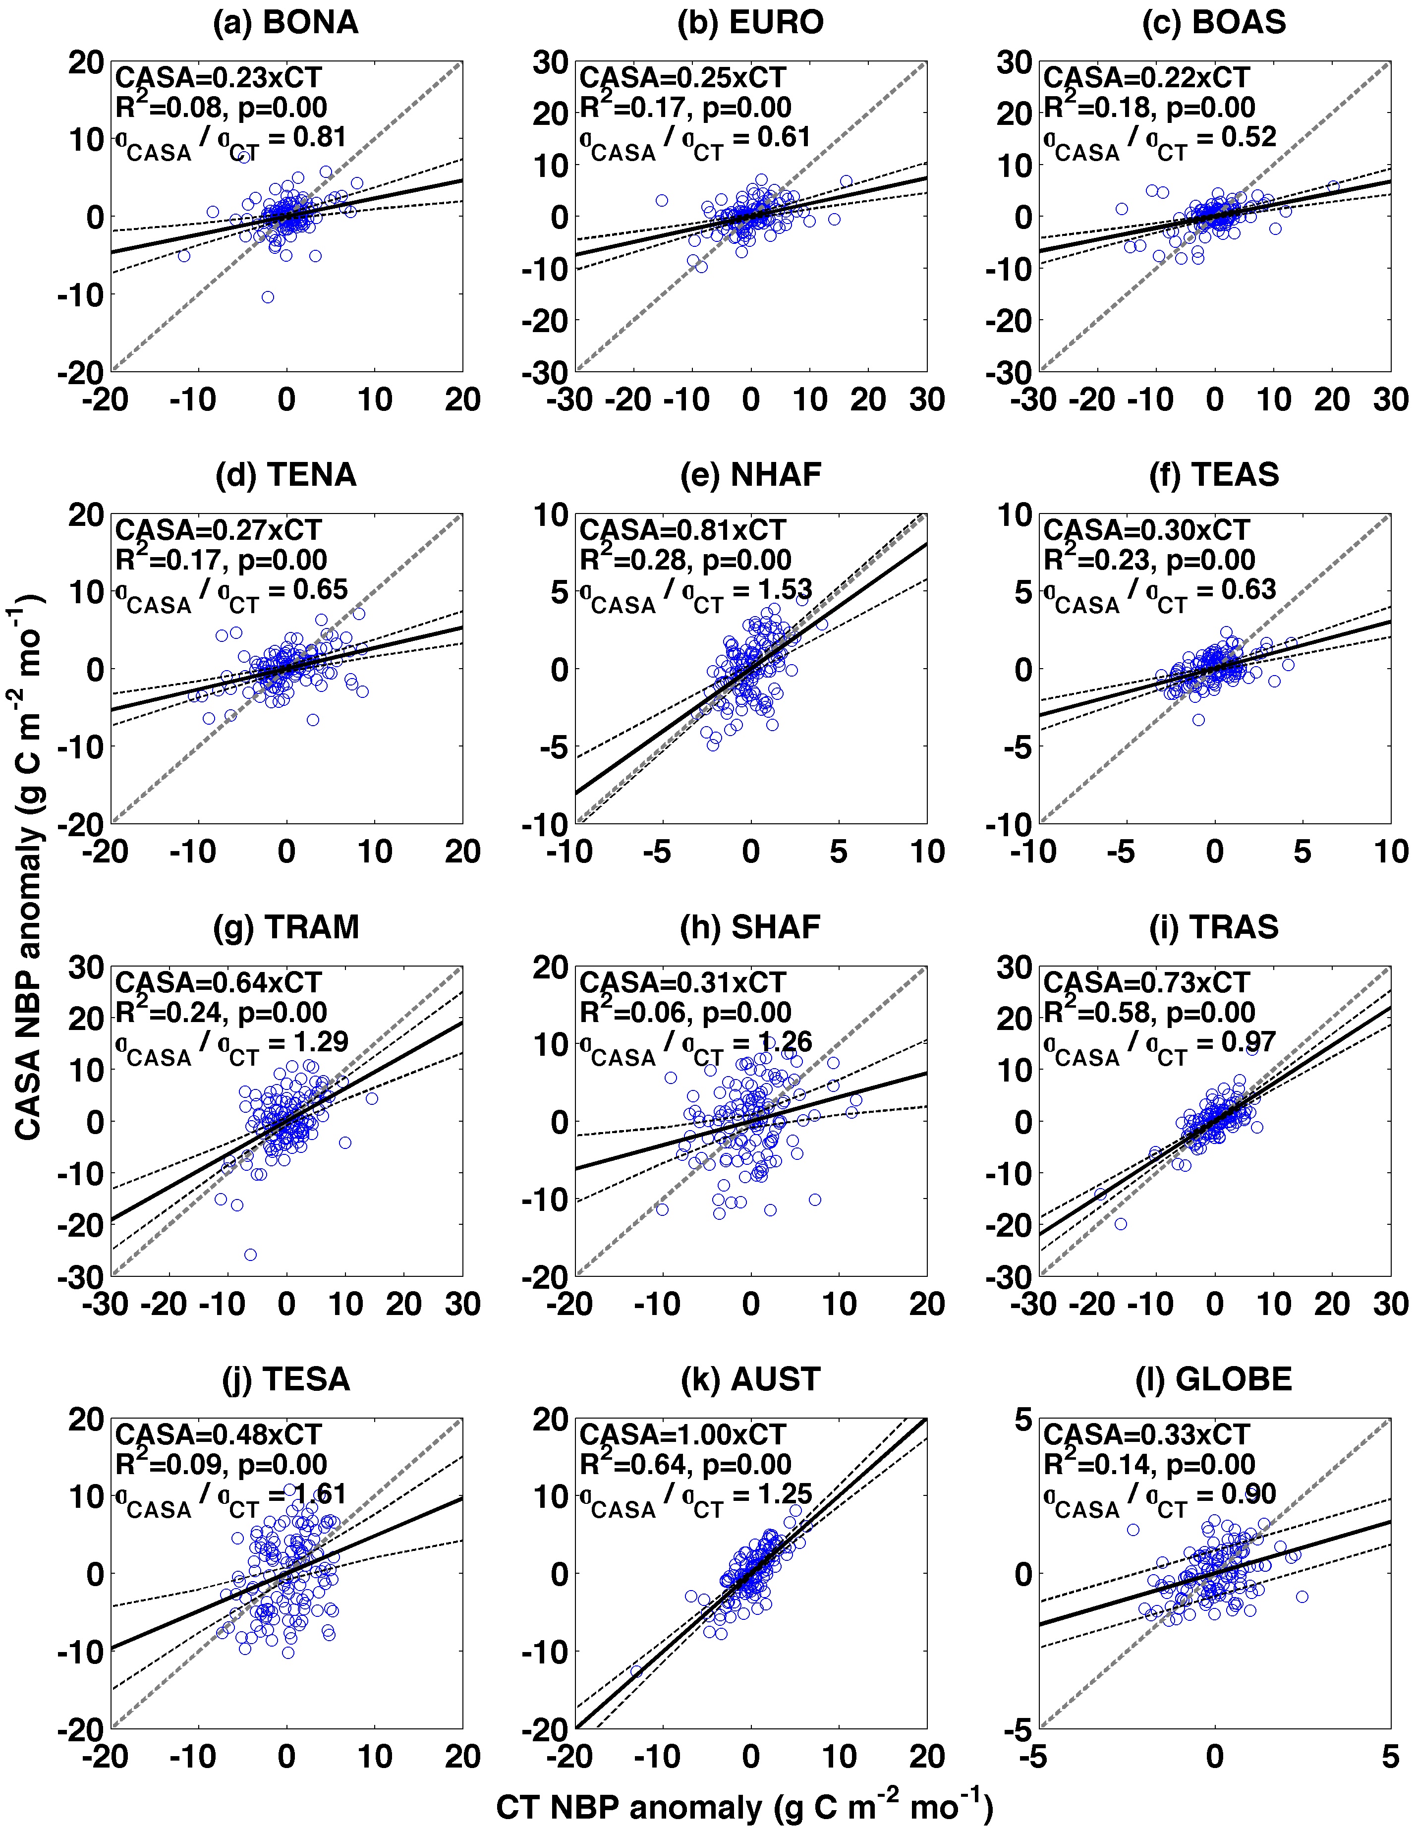
Atmospheric Inversion Comparisons
CarbonTracker 2000-2010
Monthly Anomalies

Slide 10
Flux Tower Comparisons
GPP
RE
NEE
Notes:
Model Tree Ensemble

Slide 11
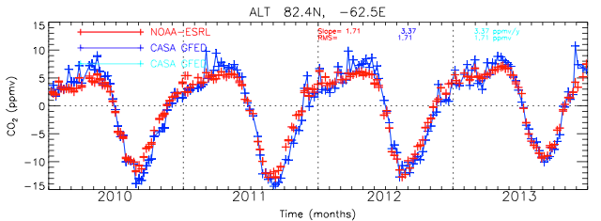
Product production history and plan
CMS web site: http://nacp-files.nacarbon.org/nacp-kawa-01/
DATA Products: Monthly 0.5º NPP, RH, Fire Emissions, Fuel wood emissions
3 hourly 1x1.25º GEE (-GPP), NEE (RE-GPP), Fire emissions
Phase 1 2009-2010
Jan ’13 2003-2011
Feb ‘14 2012
Sep ‘14 2013
anticipate Summer ‘15 2014
Flux uncertainties released upon request early ‘13
Biomass and uncertainties available but not posted or requested yet

